Slide 1
Lecture 10: Memory in Python
Understand the use of global memory, heap space, function call stack, and memory allocation
Kok-Seng Wong | 2021

Slide 2
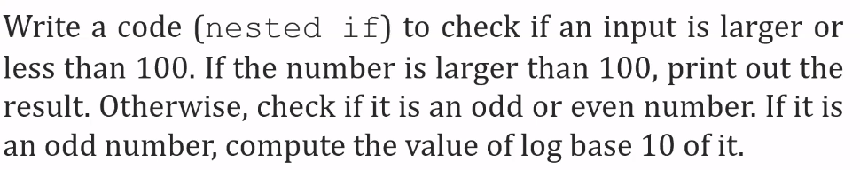
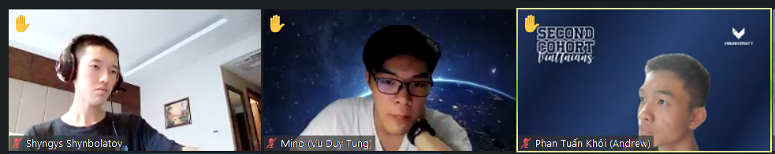
discussions

Slide 3
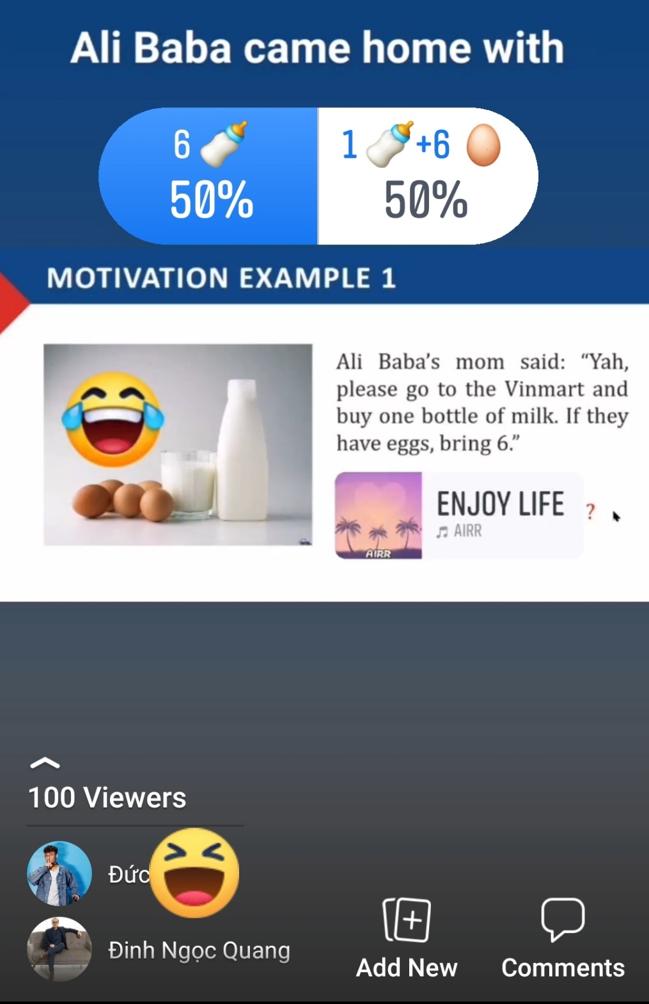

Slide 4
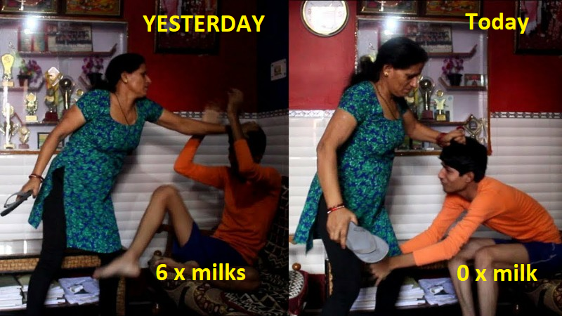
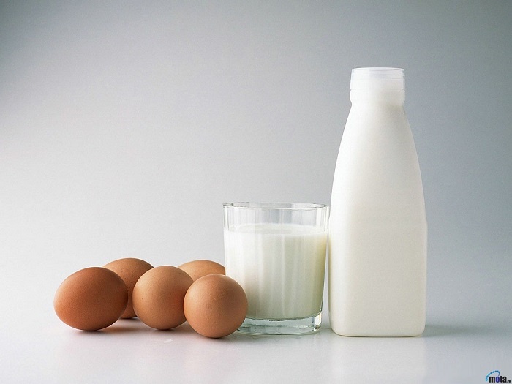
Motivation example 1
Ali Baba’s mom said: “hey, please go to the Vinmart again and buy 6 eggs. If they have milk, do not bring any.”
Ali Baba came home with ?

Slide 5


Motivation example 2
Welcome to my room!
[source]

Slide 6
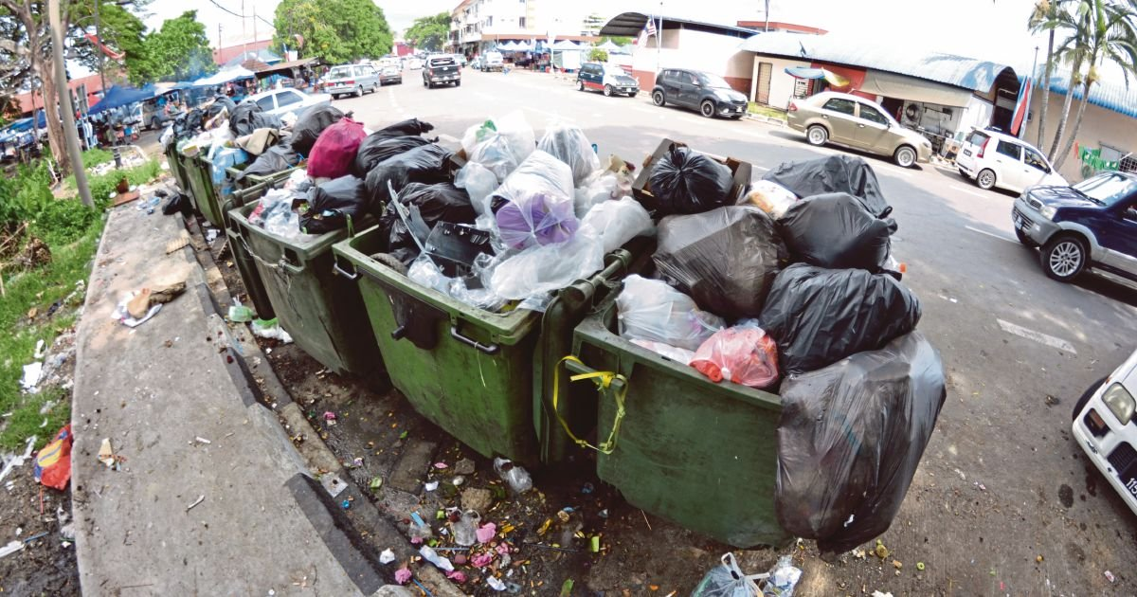
Motivation example 3
Garbage “Collector”
[source]

Slide 7
Learning outcomes
Upon the completion of this lecture, students will be able to:
understand the basics about memory management in Python.
explain why garbage collection is needed and how Python implements garbage collection.

Slide 8
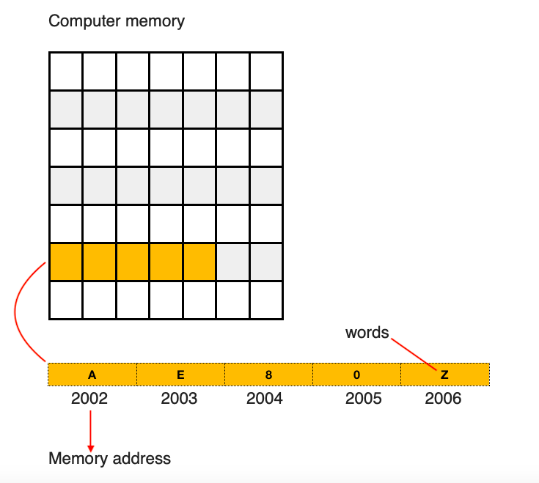
Computer memory
We need to use memory on a computer system in order to use any data structure on a computer.
Computer memory is the storage in the computer: to store data and program (instructions).
[source]

Slide 9
Memory Management
Efficient Code = Memory-Efficient Code
Memory management is the process of:
efficiently allocating
de-allocating
coordinating memory
Memory Allocation: allocation of a space (or a block) in the computer memory to a program.
Garbage Collector: automatically handles memory allocation and deallocation

Slide 10
memory management in python
Private heap: contains all Python objects and data structures.
Management of the Python heap is performed by the interpreter itself where user has no control over it!
The memory is further divided into:
Heap Memory (objects and instance variables)
Stack Memory (methods and variables)

Slide 11
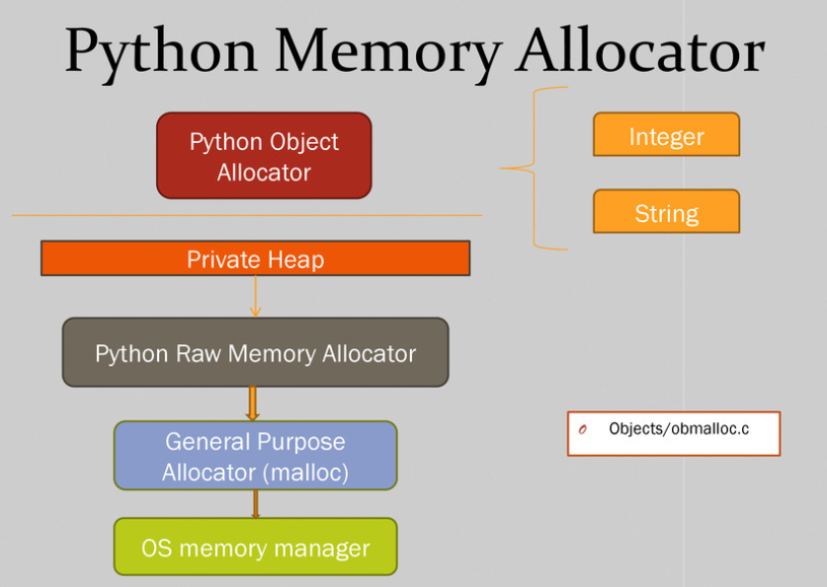
To ensure that there is enough room in the private heap for storing all Python-related data
[source]

Slide 12
Overview of Python Memory Allocator
At the lowest level, a raw memory allocator ensures that there is enough room in the private heap for storing all Python-related data by interacting with the memory manager of the operating system.
On top of the raw memory allocator, several object-specific allocators operate on the same heap and implement distinct memory management policies adapted to the peculiarities of every object type.
For example, integer objects are managed differently within the heap than strings, tuples or dictionaries because integers imply different storage requirements and speed/space tradeoffs.
The Python memory manager thus delegates some of the work to the object-specific allocators, but ensures that the latter operate within the bounds of the private heap.
Read more: https://docs.python.org/3/c-api/memory.html

Slide 13


Slide 14
Garbage collection
Process in which the interpreter frees up the memory (when not in use) to make the available memory for other objects.

Slide 15


Slide 16
Reference and reference count
import sys
v1 = 10 v2 = 10 v3 = v2 r1 = sys.getrefcount(v1) r2 = sys.getrefcount(v2) r3 = sys.getrefcount(v3) print(r1, r2, r3)
3 3 3
import sys
v1 = 10 v2 = 10 v3 = v2 v4 = v1 r1 = sys.getrefcount(v1) r2 = sys.getrefcount(v2) r3 = sys.getrefcount(v3) r4 = sys.getrefcount(v4) print(r1, r2, r3, r4)
4 4 4 4
Pointing to the same memory address
Reference count +1 when adding a new variable which is equal to 10

Slide 17
Class QUIZ
Conditionals and Control Flow

Slide 18
Global space
What you “start with”
Used to store global variables
Lasts until you quit Python
Global Space
x | 4

Slide 19
Heap space
Heap Space
id1
 |  | Point2
x | 1
y | 2
Where “folders” are stored
Have to access indirectly
Global Space
x | 4
p | id1
q | id2
x = 4
p = shape.Point2(1,2)
q = shape.Point2(10,7)
id2
 |  | Point2
x | 10
y | 7
p and q live in Global Space while their folders live on the Heap.

Slide 20
Call frame: when calling a function
Call frame: boxes for parameters at the start of the function and for variables local to the function as they are created
Deleted when call done!
Global Space
Heap Space
id1
 |  | Point2
x | 1
y | 2
x | 4
p | id1
def adjust_x (pt,n):
pt.x = pt.x + n
x = 4
p = shape.Point2(1,2)
adjust_x(p,x)
1
Call Frame
adjust_x |  |  | 1
pt | id1
n | 4

Slide 21
Call frame: when calling a function
Call frame: boxes for parameters at the start of the function and for variables local to the function as they are created
Deleted when call done!
Global Space
Heap Space
id1
 |  | Point2
x | 1 5
y | 2
x | 4
p | id1
def adjust_x (pt,n):
pt.x = pt.x + n
x = 4
p = shape.Point2(1,2)
adjust_x(p,x)
1
Call Frame
adjust_x |  |  | 1
pt | id1
n | 4
RETURN |  | None

Slide 22
The call stack
The set of function frames drawn in call order.
Functions frames are “stacked”: cannot remove one above without removing one below.
Python must keep the entire stack in memory: error if it cannot hold stack (“stack overflow”).
Function_1
calls
Function_2
calls
Function_3
calls
Function_4
calls
Function_5
Function_6
calls

Slide 23
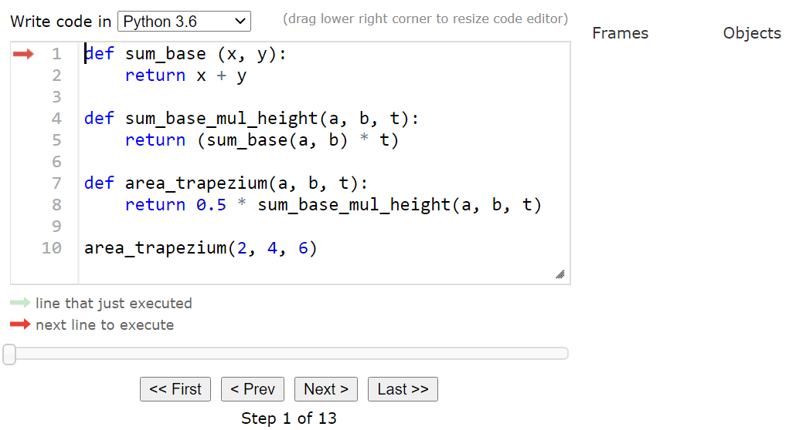
Call stack – example
[demo]

Slide 24
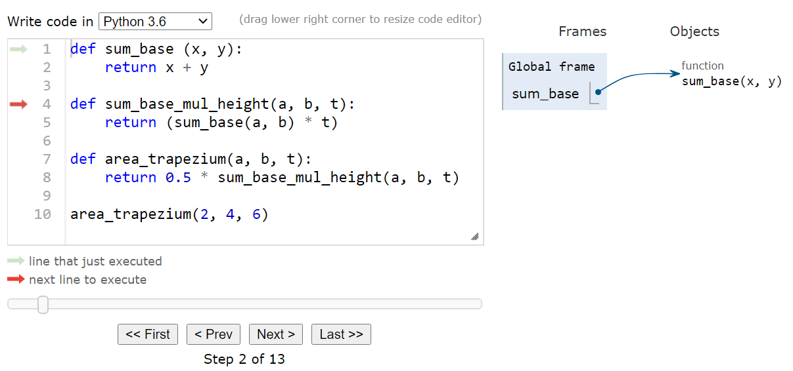

Slide 25
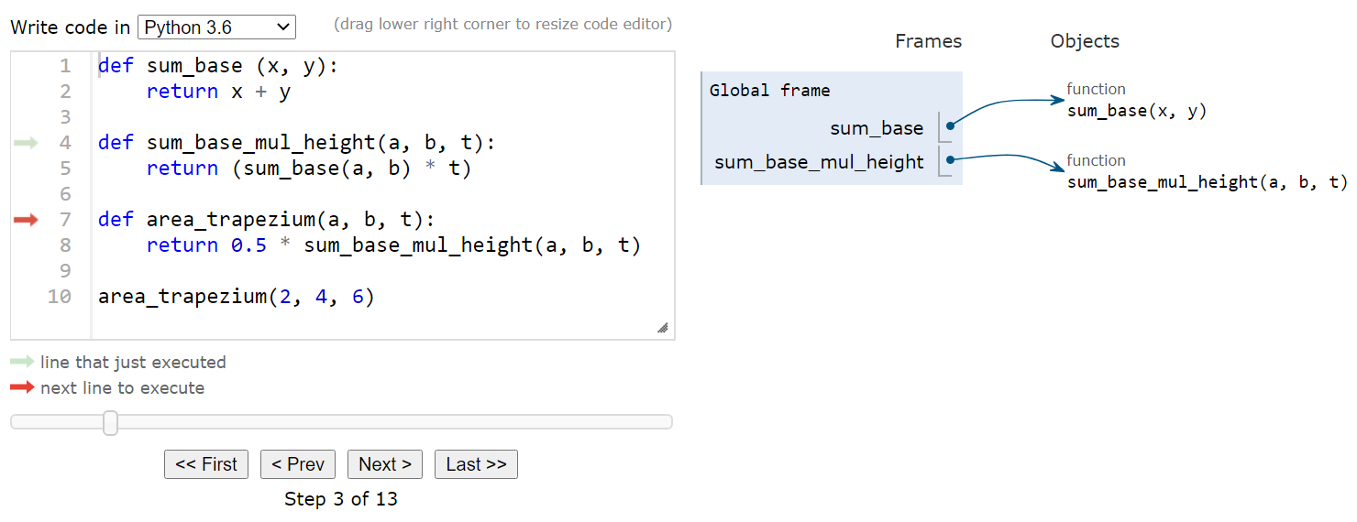

Slide 26
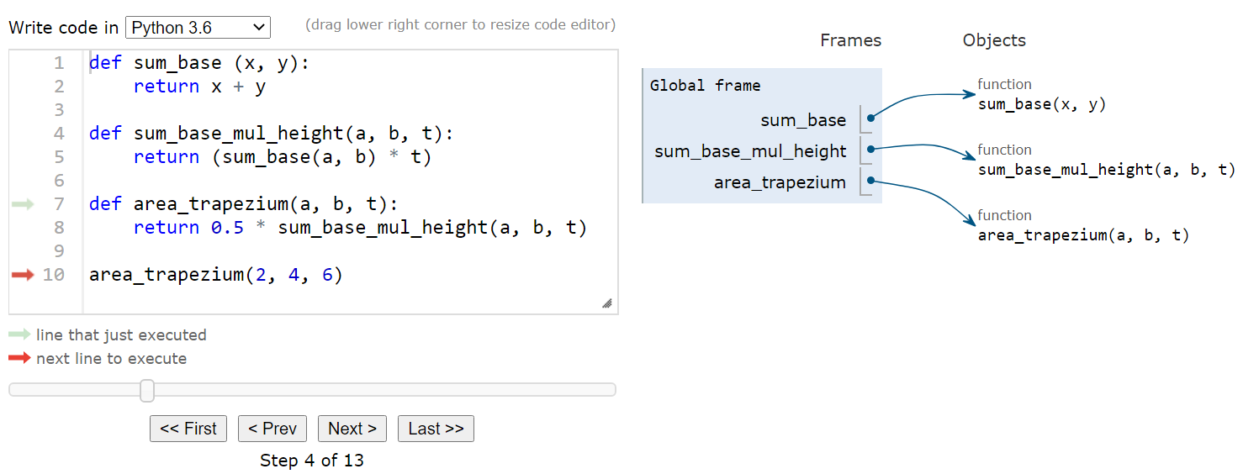

Slide 27
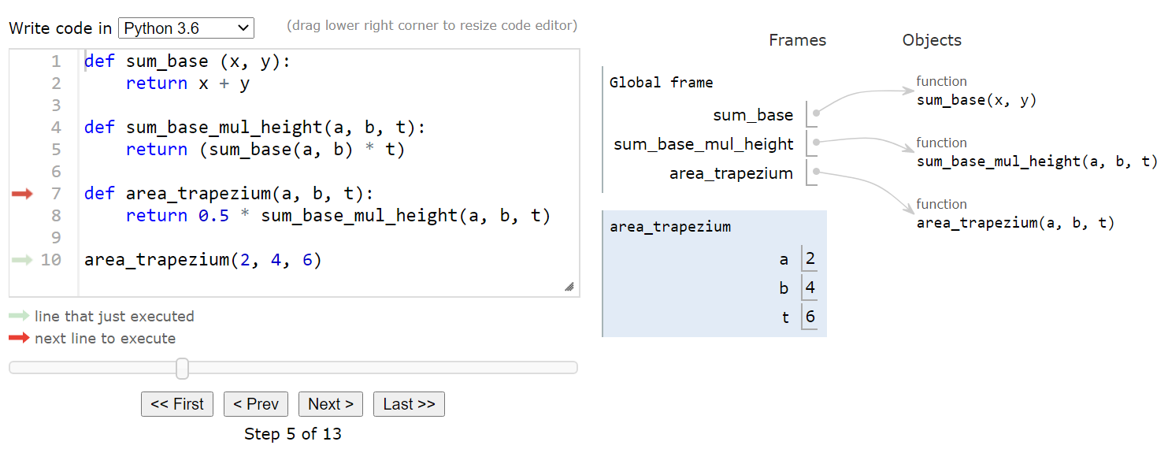

Slide 28


Slide 29
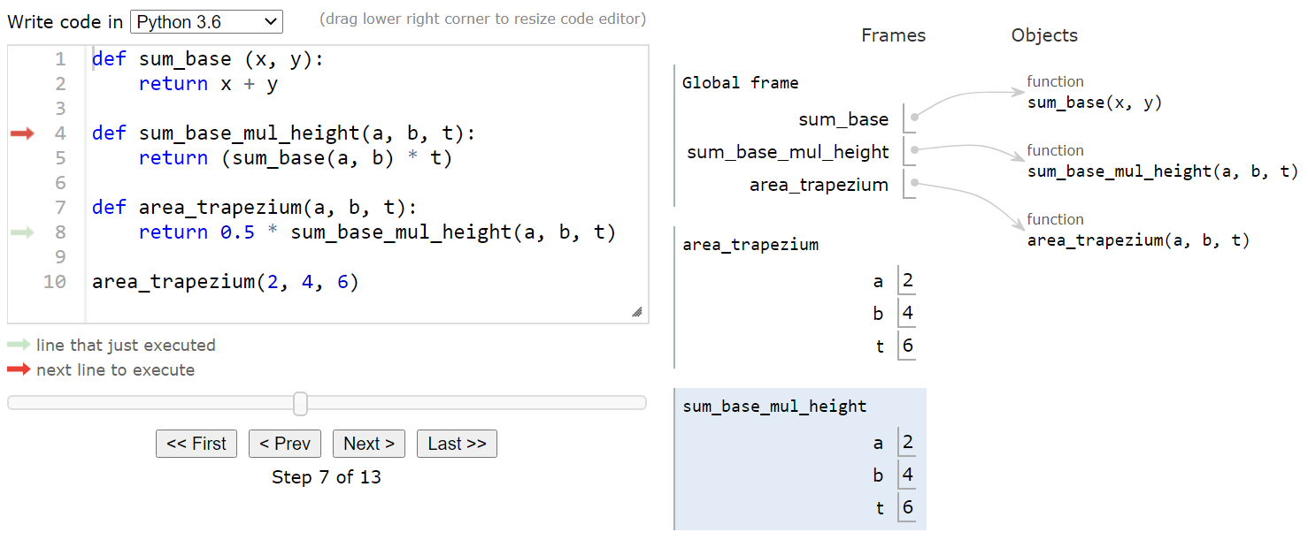

Slide 30
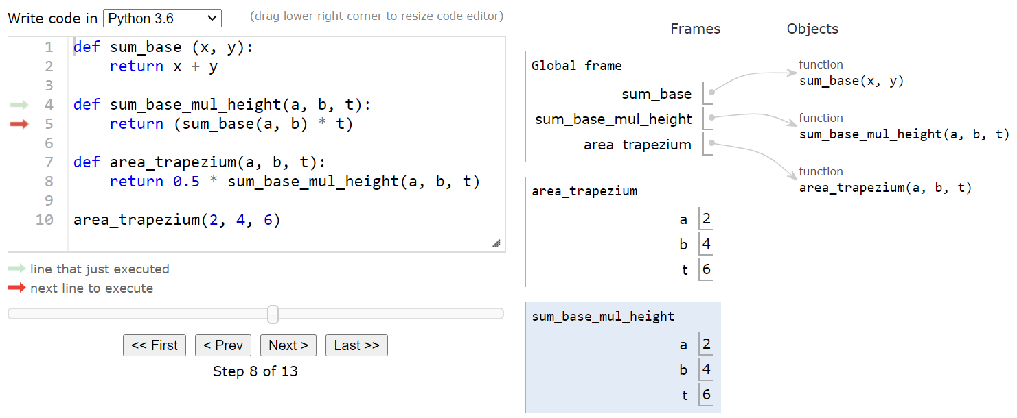

Slide 31
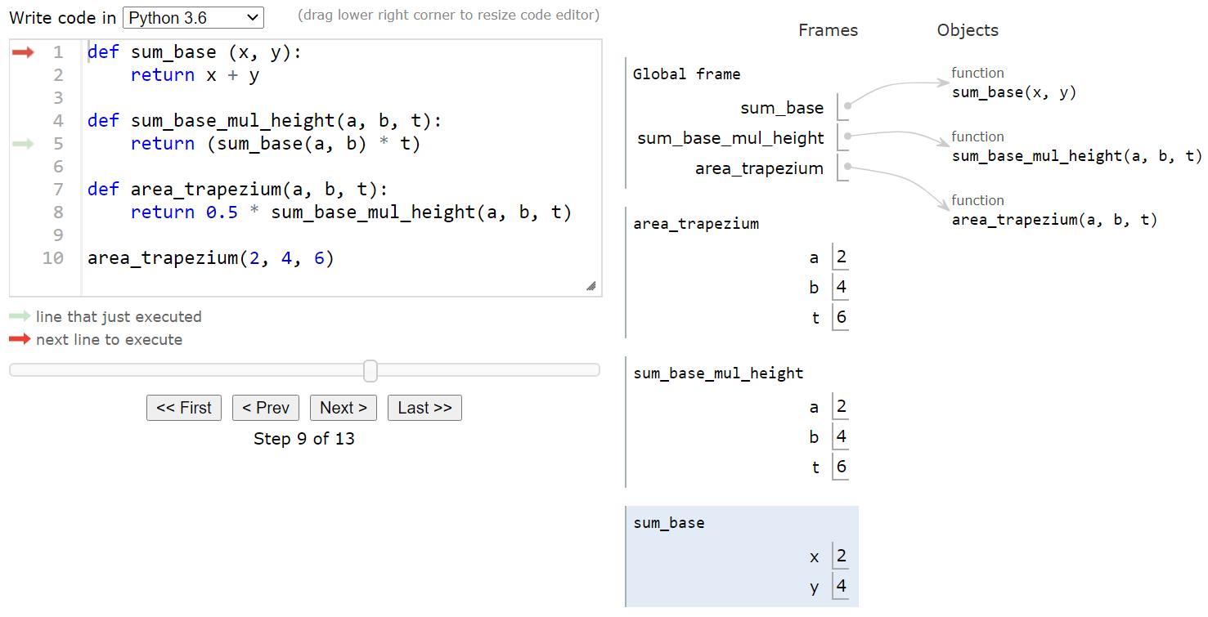

Slide 32
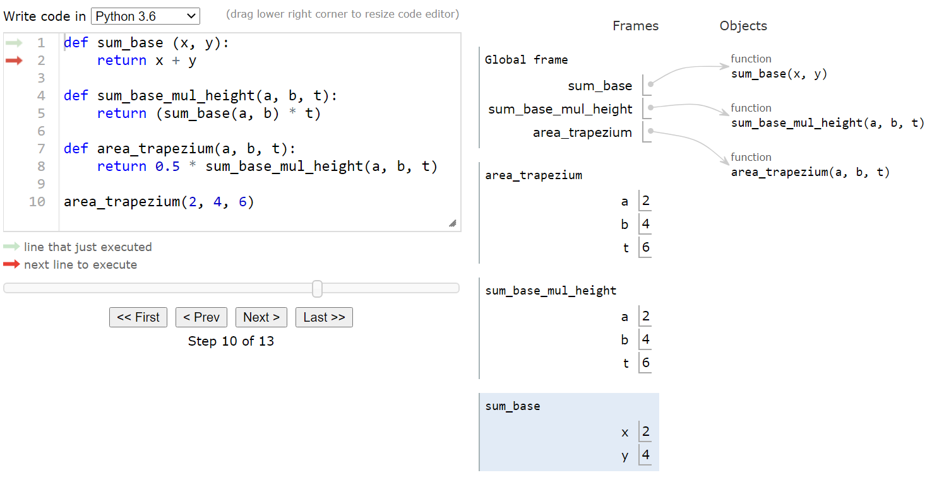

Slide 33
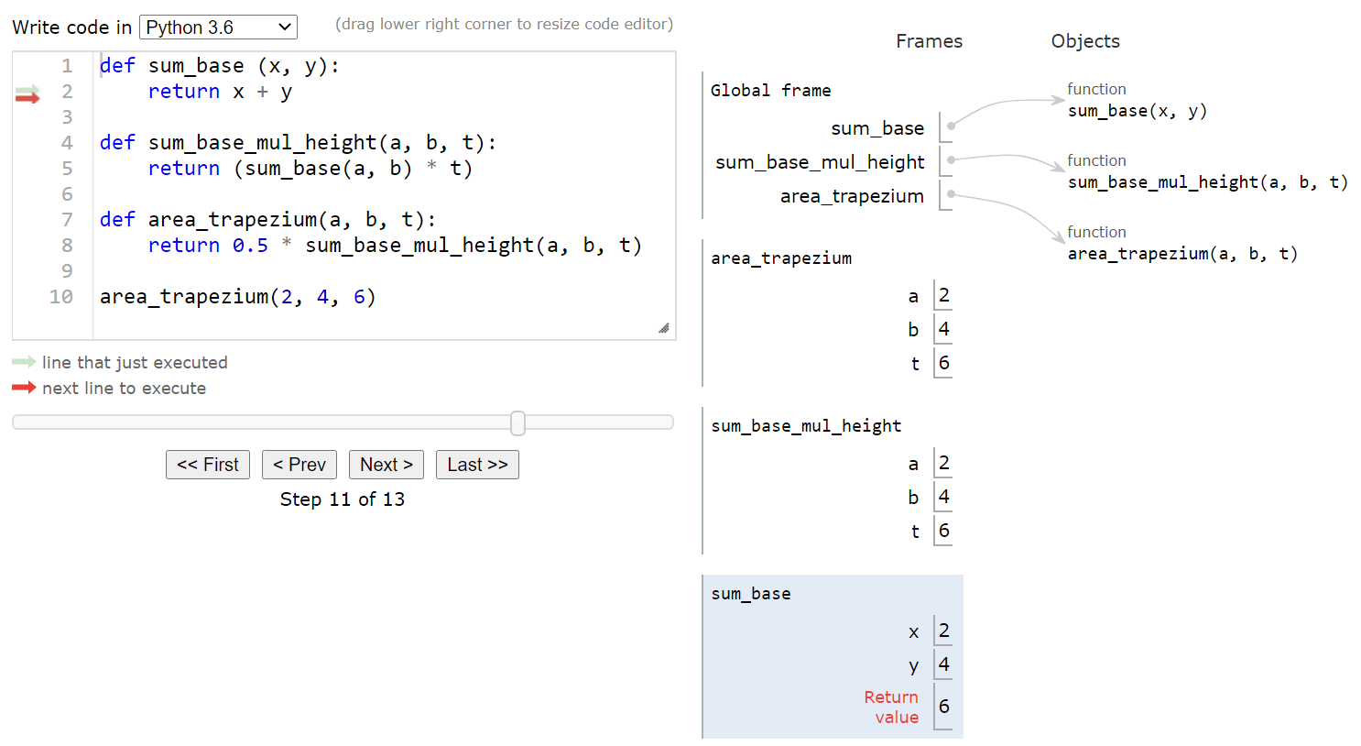

Slide 34
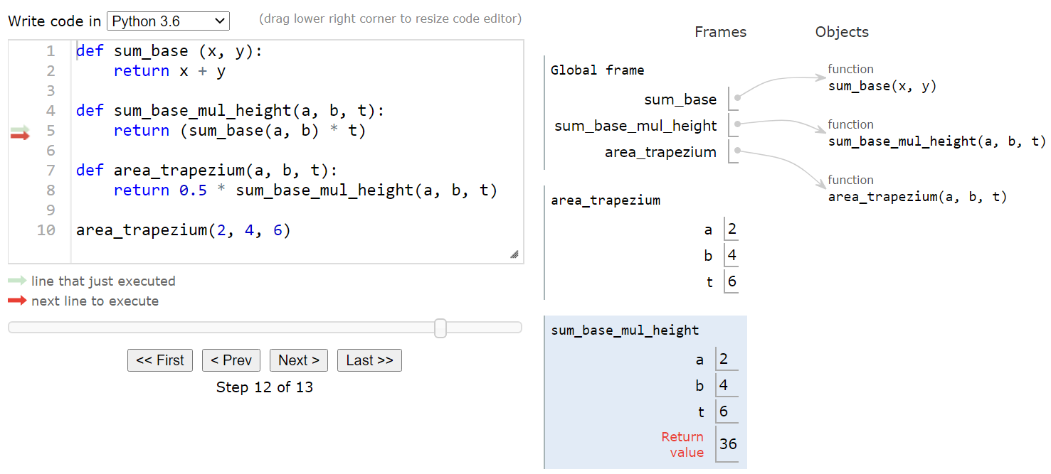

Slide 35
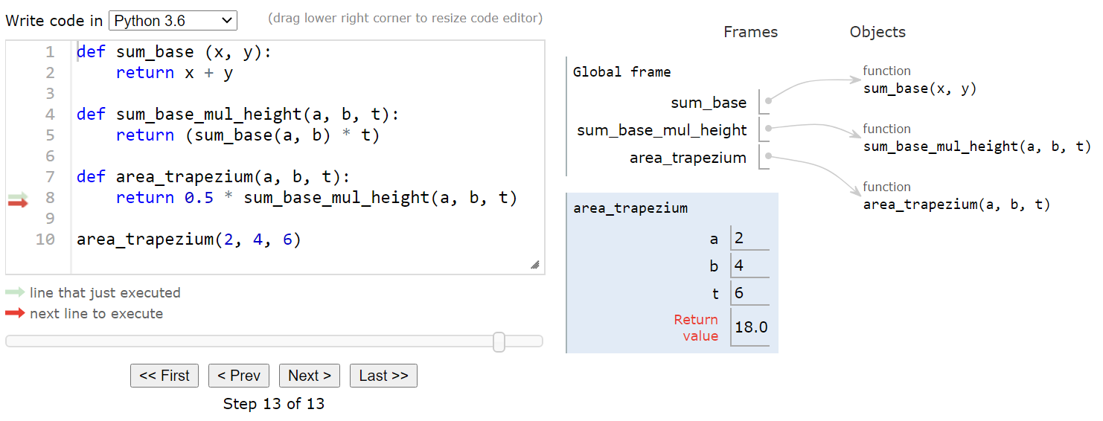

Slide 36
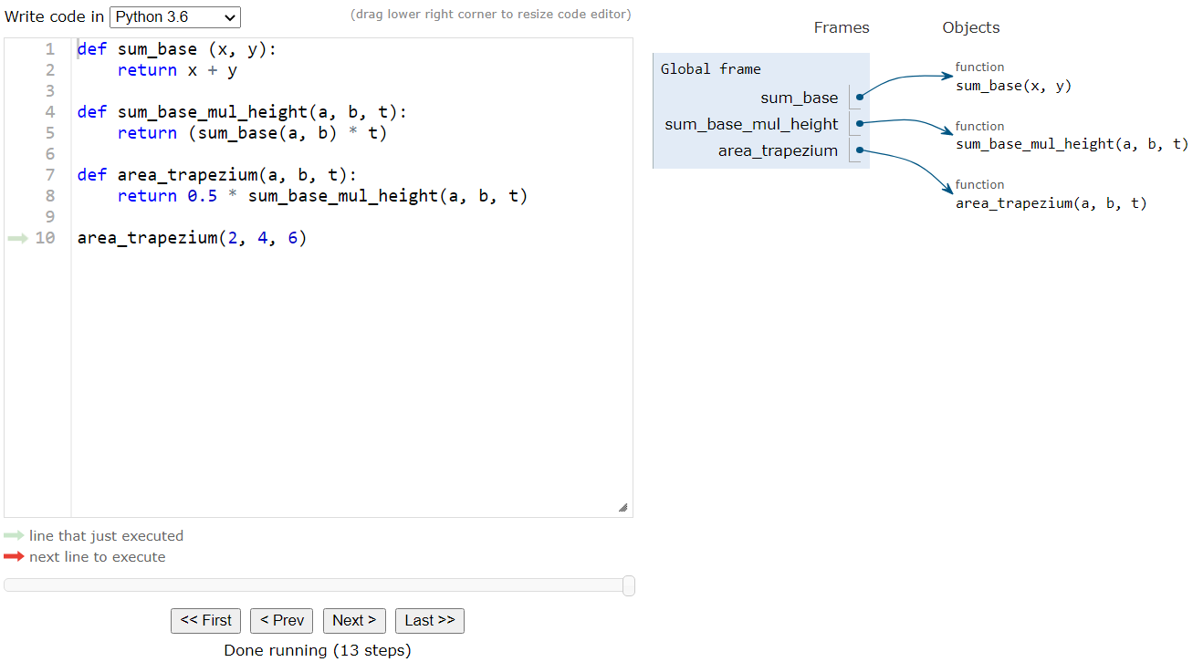

Slide 37
modules and global space
Import
Creates a global variable (same name as module)
Puts variables, functions of module in a folder
Puts folder id in the global variable
Heap Space
id4
 |  | module
pi | 3.141592
e | 2.718281
>>> import math
Global Space
math | id4
functions

Slide 38
Modules vs objects
Heap Space
id4
 |  | Math module
pi | 3.141592
e | 2.718281
>>> import math
>>> math.pi
>>> p = shapes.Point3(5, 2, 3)
>>> pi.x
functions
Global Space
id5
 |  | Point3
x | 5
y | 2
z | 3
math | id4
p | id5

Slide 39
functions and global space
A function definition
Creates a global variable (same name as function)
Creates a folder for body
Puts folder id in the global variable
Heap Space
id3
 |  | function
Global Space
def larger (a,b):
if a > b:
return a
else:
return b
x = 10
y = 20
larger(x, y)
larger | id3
x | 10
y | 20
Body
Body

Slide 40
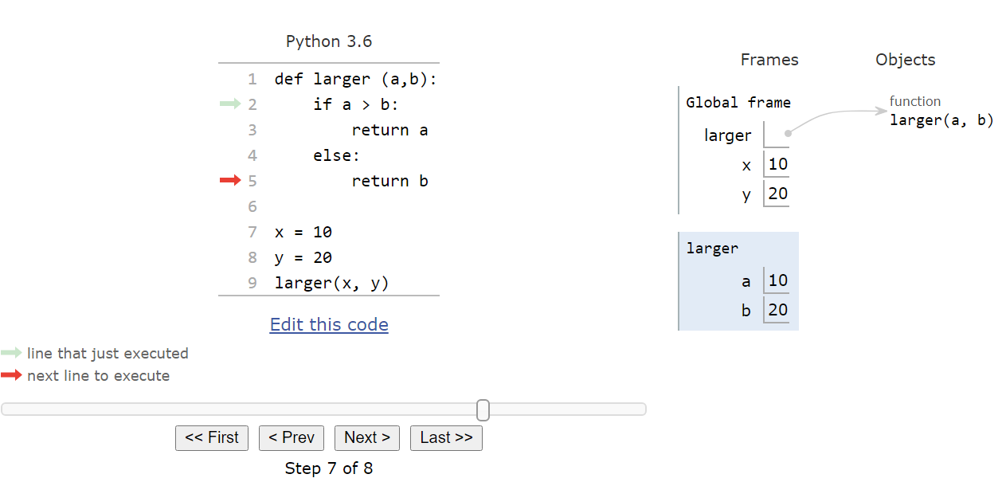
Function definition vs call frame
Global Space
Heap Space (function definition goes here)
Call Frame
(memory for function call)
[source]

